Slide 1
Sprinkler Automation:
Design & Implementation
CEILING PLAN VIEW
From room geometry to placed heads
ROOM BOUNDARY / HEAD GRID
LIGHT HAZARD / PROVISIONAL 15 FT
Notes:
Purpose: walk through what the current sprinkler placement implementation actually does, using the code as the source of truth. The deck separates three things that are easy to blur: static verification (build and tests), deterministic calculation behavior, and live Revit runtime behavior. The first two are demonstrated in this pass; the third is explicitly not. Use the cover metrics as the evidence boundary: zero build errors, 486 passing checks across 19 suites, and no live Revit scenario run. This is an internal design walkthrough, not a compliance statement and not a release decision.

Slide 2
Five stages, one calculation core
Calculate first; use Revit to read inputs and place results.
01
02
03
04
05
Normalize input
Resolve plane + rules
Generate candidates
Preflight + Apply
Place + validate
Room boundary, ceiling, openings, family type.
Hazard spacing and mounting elevation.
Grid, tile snap, boundary and separation filters.
Check family, level and host: ELIGIBLE / BLOCKED / UNDETERMINED.
Place in one transaction; read back actual XYZ.
Stages 2–3 are deterministic; Revit handles extraction, preflight and placement.
Notes:
Use this slide to orient the audience. Stage one is the Revit-aware extraction edge: boundary, openings, ceiling elevation, construction class, and the selected family behavior become normalized input. Stages two and three are the deterministic core. They resolve the hazard rule set, mounting Z, deflector drop, slope behavior, and then generate and filter the candidate array. Stage four is the eligibility preflight: it reuses the same family, level, and host resolvers, but performs only read-only queries. It returns one of three explicit states. Stage five is the only write edge: strategy selection, host and level resolution, a transaction group, instance creation, and read-back validation. The important architectural claim is not that every stage is Revit-free; it is that the calculation core is, and the Revit edges are explicit.

Slide 3
Eligibility has three states
Only eligible rooms can be selected.
BLOCKED IF
PREFLIGHT / THREE STATES
No boundary, required host, valid point, or supported family type.
ELIGIBLE
At least one point has a usable level and required host.
BLOCKED
No valid geometry, host, point, or placement strategy.
FLAGGED, NOT BLOCKED
Unknown hazard or provisional ceiling / coverage checks need review.
UNDETERMINED
Family or evaluation could not be verified.
Preflight is read-only; it creates no instances or transactions.
Notes:
The code has two gates. The calculation gate can fail because the room boundary is unusable, a ceiling-hosted family has no ceiling, no candidate survives the hard filters, or the selected placement behavior is unsupported. The eligibility preflight is a second, read-only gate. It resolves the family strategy, candidates, level, and ceiling host, but it creates no instance and starts no transaction. It returns exactly three states. ELIGIBLE means at least one candidate can actually be hosted. BLOCKED is a deterministic inability and makes the room unselectable. UNDETERMINED means the system could not prove either result, usually because the family is not loaded or the evaluation itself failed. The UI deliberately does not collapse those two into one boolean. ReviewRequired is not a gate; it is a calculation status that still produces a plan.

Slide 4
Mounting elevation depends on the host
XY can be correct while Z is wrong.
FLAT CEILING / CEILING HOST
SLOPED CEILING / AVERAGED Z
CEILING-HOSTED
ONE-LEVEL
WALL / SIDEWALL
Requires a usable ceiling face.
Requires a level; no ceiling host.
Requires a wall face.
Sloped Z is estimated from ceiling elevations; the peak check is a flag.
Notes:
Z is not just a number from the room. For a ceiling-hosted family it comes from the resolved ceiling face, and the code then applies the shallowest legal deflector drop: one inch below the mounting plane. For unsupported ceilings it falls back to a numeric ceiling height or even floor level and marks the result provisional. The sloped path is important to explain honestly: the current code averages the bottom and top elevations and places on that averaged plane, then compares the averaged plane to the peak against the three-foot rule. That is a flag, not a geometric solution, and it is not a per-head peak optimization. Host requirements differ by family. Ceiling and work-plane families need a usable ceiling face; one-level families need a level; sidewall families need a wall face. The preflight is what turns those requirements into blocked or undetermined.

Slide 5
Generate candidates, then filter
Spacing sets the grid; geometry and separation rules decide what survives.
ARRAY MATH / CONCEPTUAL
nx = ceil(W / S) ny = ceil(H / L)
Clamp overrides, snap to ceiling tiles, then reject boundary, clearance and separation conflicts.
LIGHT / PROVISIONAL
15 ft spacing | 225 ft² per head | 7.5 ft radius
ROOM EXTENT
S ≤ 15 FT
L ≤ 15 FT
Head count is an estimate, not a hydraulic calculation.
Notes:
The array is a generated candidate set. Spacing and coverage rule values produce a grid, and the code has two array paths: a free spacing grid, and a ceiling-tile-centered path when the ceiling grid is readable or the user supplies a tile size. Those are not the same geometry. Edge points are tested against the room polygon, the boundary clearance, minimum spacing, and separation from existing heads. The selection step then chooses a subset rather than accepting every intersection. Emphasize the conceptual formula: it explains the spacing count, not every optimized tile path. RequiredCount is an arithmetic estimate. It is not a hydraulic count, and passing it does not prove coverage.

Slide 6
Reject hard conflicts; flag advisories
Rejected points are removed; warnings do not relocate points.
HARD FILTER / CANDIDATE REJECTED
POST-CHECK / STATUS OR WARNING
Inside room boundary
Meets edge clearance
At least 6 ft between new heads
At least 6 ft from existing heads
Obstacle: flagged; point stays
Three-times rule: reported
Beam, spacing, wall and slope checks: flagged
Coverage / remote distance: advisory
GENERATE
HARD FILTER
SELECT
POST-CHECK
STATUS
Obstacle flags report conflicts; they do not move points.
Coverage is advisory; no hydraulic calculation is performed.
Notes:
This is the distinction that matters most in the code. Hard filters reject a candidate. They are geometric: inside the room, inside the boundary inset, at least six feet from another selected head, and at least six feet from an existing sprinkler. Post-checks do not reject. They record a warning, a status, or a conflict flag. Obstacle conflict is a flag. The Three Times Rule is a report. Beam conflict is a report because the beam lookup table is not available. Max-spacing gaps, max wall distance, sloped peak, and coverage are status or warning paths. Coverage and remote-distance sampling are advisory only. RequiredCount is arithmetic. Nothing in this slide should be presented as hydraulic proof.

Slide 7
Operator choices precede placement
Review configuration, confirm prompts, then apply.
PATH
THREE CONFIRMATIONS
01
Select rooms
OBSTACLE PROMPT
Only ELIGIBLE rooms are available.
Yes: place all points. No: skip flagged points.
02
Choose family + type
The family type determines its placement strategy.
REPLACE CONFIRMATION
03
Set hazard + overrides
Existing heads in selected rooms are deleted; undo restores them.
Review hazard class and spacing values.
04
Review configuration
Configuration table only; no point preview.
MISSING FAMILY
Continue where available, or cancel and load the family.
05
Apply + read report
Confirm prompts; apply once; review placement status.
Cancel rolls back the transaction group.
Notes:
Walk the operator through the actual sequence. The first step is room selection; only rooms whose eligibility state is ELIGIBLE are selectable. BLOCKED and UNDETERMINED remain visible but are not collapsed into one disabled state. Next is family and type selection, then hazard and spacing inputs. Final Review is a configuration table, not a point preview. This matters because Apply is not a visual approval step. Apply itself has explicit decision points. The obstacle prompt is a required Yes or No: Yes places every computed point, No skips points flagged with an obstacle conflict. If Replace is selected, a second confirmation warns that existing sprinklers in the selected rooms will be deleted. Missing families produce a modal that can continue with available rooms or cancel. Cancellation is polled only at room boundaries, and the transaction group rolls back the whole run. The report then separates placed-and-valid, placed-but-invalid, failed, skipped duplicates, and skipped rooms.

Slide 8
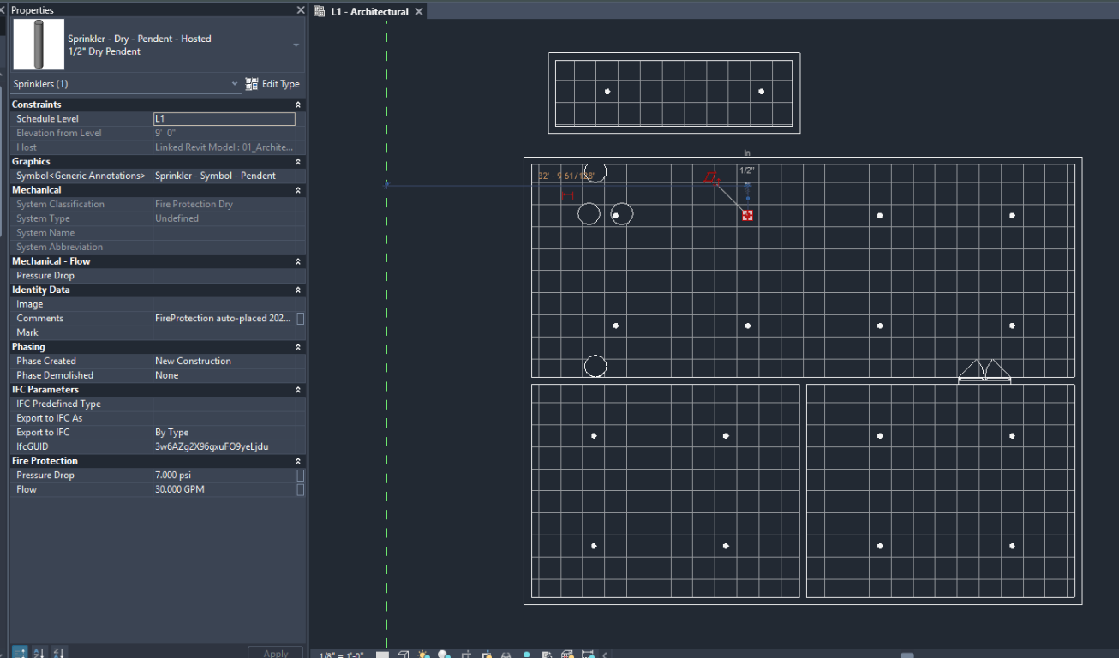
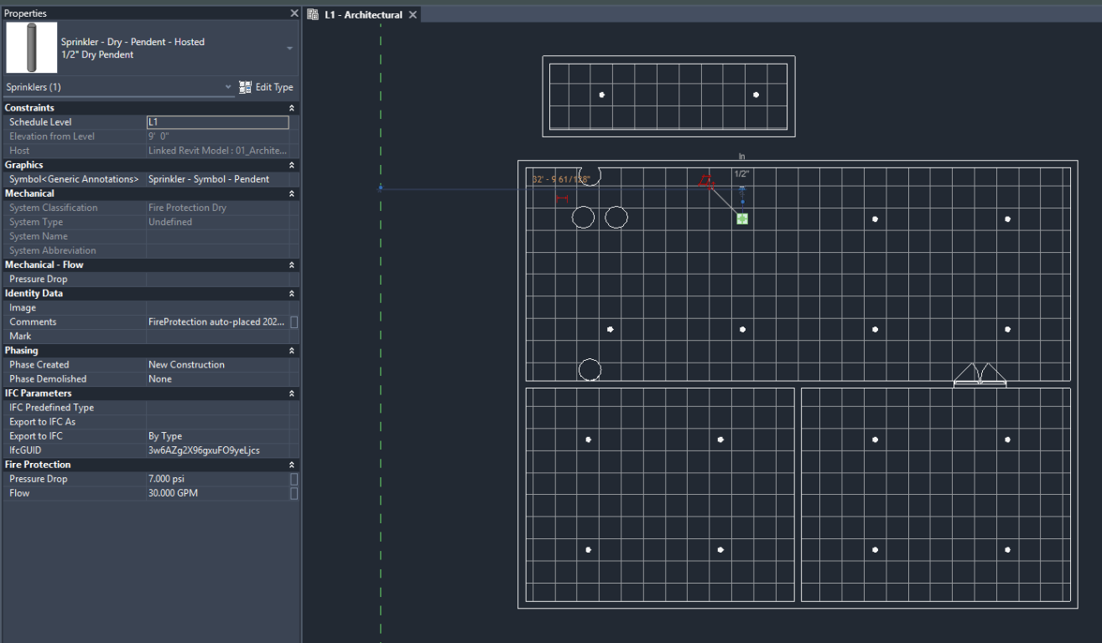
OBSTACLE PROMPT
Two test cases: Yes and No
Plan views from the Yes and No obstacle-prompt runs.
YES CASE — PLAN VIEW
NO CASE — PLAN VIEW
Report: 34 of 34 requested sprinklers placed.
Report: 33 of 34 requested sprinklers placed.
One obstacle-conflicted point was not placed; see next slide.
Counts and room status are from the uploaded placement reports.

Slide 9
JSON TEST RESULTS
Placement outcome by choice
Same 7 rooms and 34 requested points; both reports use provisional rules.
YES CASE
NO CASE
34 / 34
sprinklers placed
33 / 34
sprinklers placed
7 of 7 rooms succeeded
6 of 7 rooms succeeded
0 rooms require review | 0 failed rooms
1 room requires review | 0 failed rooms
NO CASE | Room Name 100 | L1
7 of 8 points placed. One point was not placed because an obstacle was detected at (20.79, 44.62).
Both overall reports are ReviewRequired because the spacing rules are provisional. Room-level review: Yes 0; No 1.

Slide 10
Placement is explicit and verified
Type, host, transaction and read-back must all succeed.
FaceBased
face host
1
Transaction group starts
0.5
FT / VALIDATION TOLERANCE
WorkPlaneBased
ceiling face
2
One transaction opens
3
Rooms are processed
Read back actual position and compare it with the requested point.
OneLevelBased
level only
4
Transaction commits
Missing location or deviation > 0.5 ft = invalid.
WallSidewall
wall face
5
Group assimilates
Cancel rolls back the full run.
Placed > 0 | Failed = 0 | Invalid = 0
MISSING FAMILY / SKIP ROOM
UNSUPPORTED TYPE / FAIL POINT
HOST MISSING / FAIL POINT
BAD READ-BACK / FAIL RUN
Linked geometry is transformed once during extraction; placement does not transform again.
Notes:
The placement seam is narrow by design. Strategy selection is based on the proven FamilyPlacementType, with an explicit sidewall override when the point carries a WallEdgeIndex. If no strategy handles the proven type, the point fails; there is no default-to-level fallback. The write is one transaction inside one transaction group. Cancellation is checked at room boundaries, and the group rolls the run back. After creation, the code reads the actual LocationPoint and compares it with the expected host target. The tolerance is 0.5 ft. A missing LocationPoint or a larger deviation produces PLACED_BUT_INVALID, and the overall success condition fails. The failure semantics matter: a missing family skips the room, an unsupported family type fails the point, a missing host fails the point, and an invalid read-back fails the run. Finally, linked geometry is already normalized to host coordinates during extraction; placement must not apply a second transform.

Slide 11
Two runtime cases tested; rules provisional
Yes/No obstacle results are captured in the placement reports.
VERIFIED IN TWO RUNS
NOT COVERED BY THESE RUNS
DECISIONS REQUESTED
01
YES RUN
01
OTHER HOST CASES
01
Choose obstacle response: flag, skip, or relocate?
34/34 placed; 7/7 rooms succeeded.
Other host and read-back cases remain untested.
02
NO RUN
02
UNDO / ROLLBACK
33/34 placed; 6 succeeded; 1 needs review.
Undo and rollback were not tested in these runs.
02
Should provisional checks block Apply or warn?
03
BUILD + TESTS
03
RULE BASIS
Build: 0 errors. Tests: 486 checks, 19 suites.
No approved rule set; values are provisional.
03
Point-level results: table, report, or both?
Next: approve the rule basis; test the remaining host and rollback cases.
Notes:
Close on the evidence boundary. What is proven here is the static trace, the explicit three-state preflight, and the build and test result. What is not proven is live Revit hosting, the operator experience in a real model, and an approved rule basis. The three questions are the decisions requested from the room. First, is no-shift actually the right default policy for obstacles, or should the operator be forced to review each conflicted point? Second, should provisional warnings block Apply, or only warn? Third, where should point-level results live: the final-review table, the written report, or both? Do not ask for production approval. The next step is to confirm the rule basis and run the live-model checklist.

